Slide 1














Capstone Project presentation
CodeBlasters

Slide 2
MEET OUR TEAM
Sai Sreepadha (202301042)
Siva Suhas (202301050)
Sri Sai (202301138)
Viswa Vignan (202301160)

Slide 3
Problem Statement
Developing a TV Channel Scheduler tailored for families to efficiently record and enjoy their preferred TV series, considering potential conflicts of interest among N family members who follow M series. The Scheduler aims to reduce the total number of missed episodes and notify members based on their individual availability slots.

Slide 4
Our code efficiently reduces the number of misses by prioritizing the schedule for each time slot. This means that we focus on filling the slots where there's only one person available, ensuring that fewer opportunities are missed.
01.
Features Of Our Code
It ensures every user has satisfied the minimum condition and has less number of series missed.
02.

Slide 5

Chosen Data Structures
Unordered set
unorderd map
Vector

Slide 6
Unordered Set
Unordered set is a container which holds the data in unordered manner.
It is used to store data regarding the series taken as input.

Slide 7
Unordered Map
Unordered map stores elements (key value and mapped value) in unordered manner.
It is used to store members who are available for particular slot

Slide 8
Vector
It is a 1-D data structure used to store elements of same data type dynamically.
It is used to store the data of members to be notified and their respective series based on time availability.

Slide 9
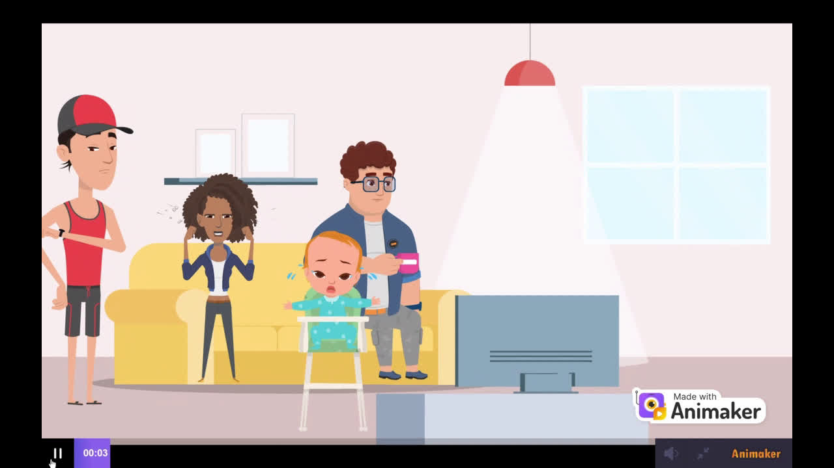

Slide 10
ALGORITHM FOR SCHEDULER FUNCTION

Slide 11
1
Iterate Through Hours of the Day:
Loop through each hour from 0 to 23.

Slide 12
2
Calculate Total Slot Length:
Initialize length to 0.
Iterate through each record in records.For each record, add the value of the time slot for the current hour (hour + 1) to length.

Slide 13
3
Check for Multiple Occupied Slots:

Slide 14
If length is greater than 1, indicating multiple people have this slot:
Initialize common_series to store series common to all persons.
Initialize temp2 to keep track of already encountered series.
Initialize max_common_series to store the count of each common series.
Iterate through each record in records.
For each record with a time slot of 1 for the current hour:
Iterate through each series in the record's Series_Names.
If the series has been encountered before (temp2.count(series) > 0), add it to common_series and increment its count in max_common_series.
Otherwise, add the series to temp2 and increment its count in max_common_series.

Slide 15
If common_series contains at least one common series:
Find the most common series among all persons.
For each record with a time slot of 1 for the current hour:
If the record contains the most common series, add the record's person name and series to output_data, remove the series from the record's Series_Names, and update slot information.

Slide 16
4
Handle Single Occupied Slots:
Loop through each hour again.
If the slot for the hour is occupied by only one person:
Assign the slot to that person if they have remaining series.
Update slot information accordingly.

Slide 17
5
Handle Unassigned Slots with Multiple Requests:
Loop through each hour once more.
If the slot for the hour is requested by multiple persons but no one has remaining series:
Assign the slot to one of them and update slot information.

Slide 18
6
End of Function: Return.

Slide 19
O(M*N)
Time Complexity
Where M is number of members , and
N is number of time slots

Slide 20
O(M*N)
Space Complexity
Where M is number of members , and
N is number of time slots

Slide 21

Final reflections and future steps
After implementing the scheduler for the first day, we can pass the vector storing the person records to the new scheduling function along with the new record. When passing these records to the new scheduling function, we prioritize slots with only one person for the previously missed series. Later on, part of the code functions similarly to the previous code.

Slide 22

LINK

Slide 23
Video Link
https://1drv.ms/v/c/31d67a036e7cd5d7/EWaouPFrRypAlo88s9CDdisBZYX4QxoTdsFxNC8LrpDAaQ

Slide 24
THANK YOU

